Slide 1
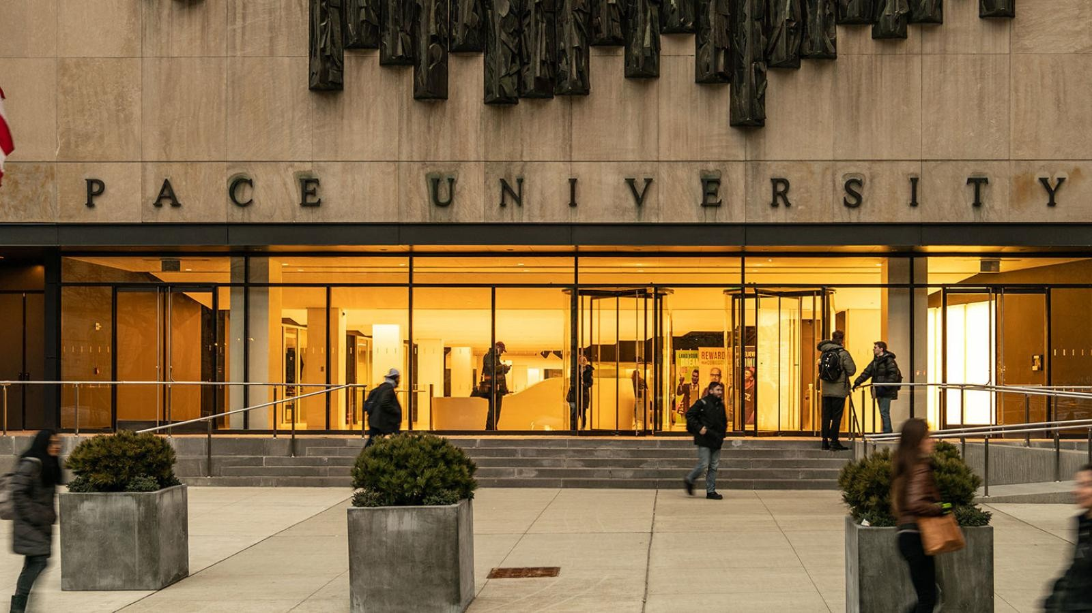

Slide 2

Computer Science Project I
CS691
Team Name Technocrats
Team 1

Slide 3
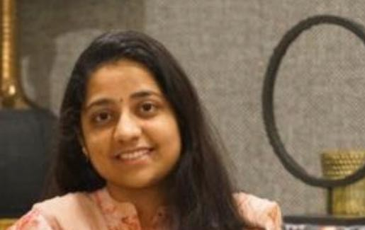
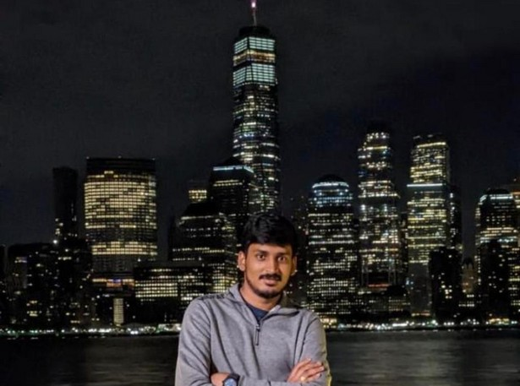
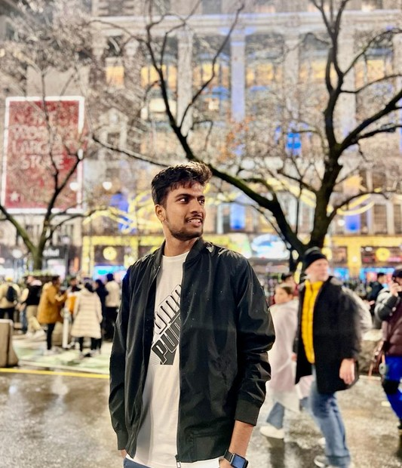
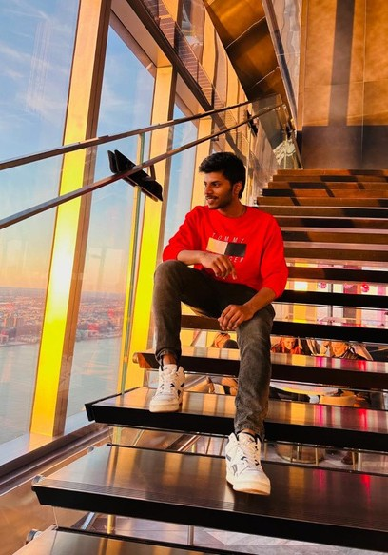
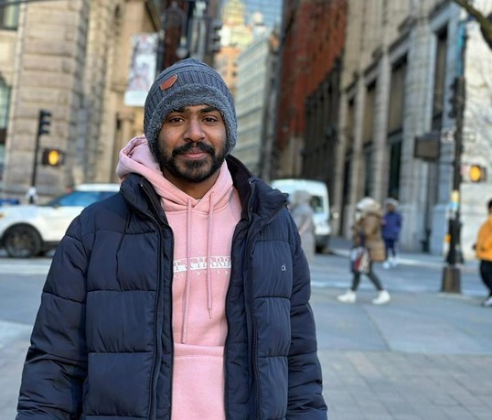

Team Member Roles and Responsiblities
Sai Sindhu Developer
Nikhil Scrum master
Sahith Quality
Analyst/Tester
Anil Babu Developer
Anvi Reddy Developer
Bhardwaj
Machine learning Engineer/Developer

Slide 4

Project Name
Covid-19 Safety Protocol Tracker Using Object Detection Model

Slide 5


Description
The ongoing Coronavirus disease (COVID-19) outbreak has driven health to the top of the priority in our lives, bringing the entire world to a halt.
Since its inception, our way of life has drastically changed. Life is slowly returning to normal after two years, but no one is fully immune to infection.
Experts advise that masks and physical separation are necessary even after vaccination. While offices have begun to reopen, the necessity to ensure security in the complexes has become critical.
In this scenario, our main attention should be on following the safety rules so that we can get back to our normal routine as quickly as possible.

Slide 6
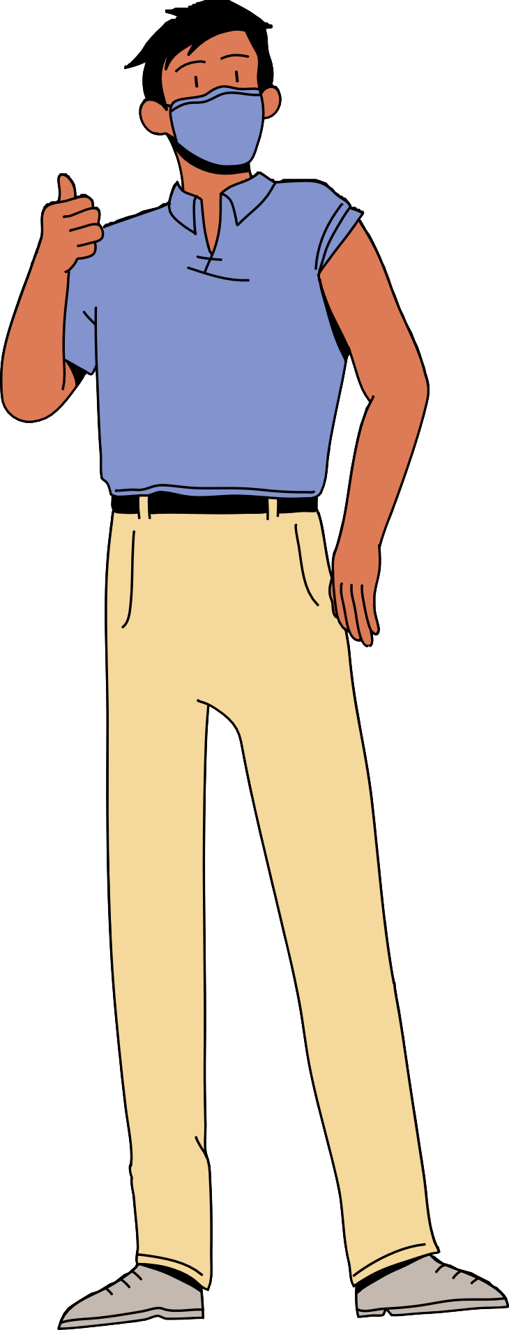
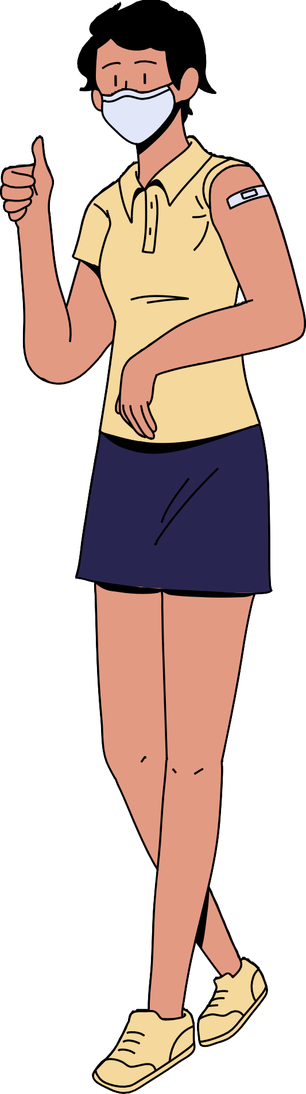
TRYING TO SOLVE
Covid19 safety protocol tracker can be used in public areas, restaurants and hospitals to monitor face mask, social distance between people.

Slide 7


Technology and
Algorithm
YOLO Object detection Algorithm Python
Machine Learning

Slide 8



TEAM MEETING
WE ARE HAVING TEAM MEETING WEEKLY TWICE ON WEDNESDAY AND SATURDAY

Slide 9
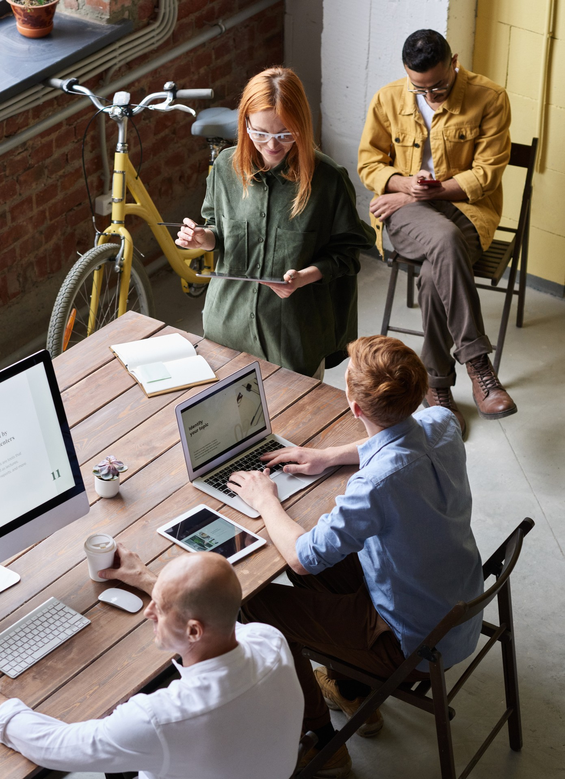
COMMITMENTS WE TOOK AS TEAM MEMBERS
As a project team, we will commit to only taking on tasks that we have the capability and skills to complete, be honest and straightforward when it comes to the plans, timeline, staff and budget, be proactive in trying to foresee and avoid difficulties, keep all team members in the loop, prioritize the overall success of the project, and follow through to the end.

Slide 10
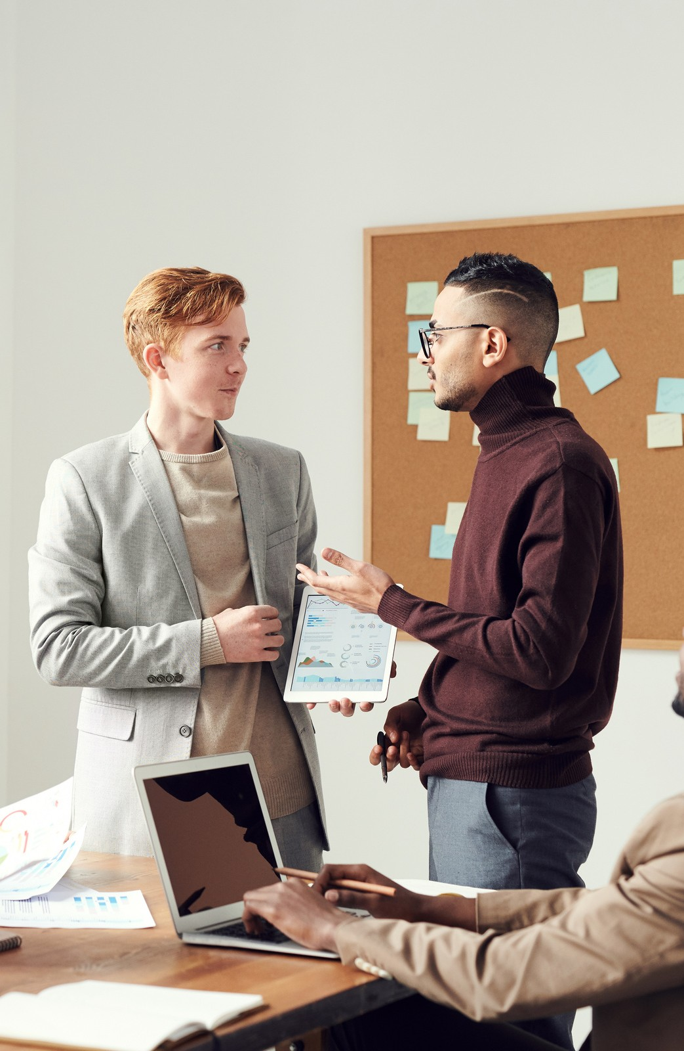
Rules for team meetings
Participation:
At our meetings, we will maintain confidentiality, promote honesty and transparency, value diverse perspectives, provide equal chances for input, be open to new ideas, and focus on how to improve processes instead of blaming people when issues occur.
Communication:
We will strive to comprehend before being heard, be concise and precise, actively listen, remain focused on the topic at hand, and utilize visuals to help with the conversation.
Problem Solving:
We aim to stimulate active participation from all members, welcoming any and all suggestions without judgement. We will work together, leveraging our collective knowledge and wisdom to come up with solutions.
Whenever possible, we will use data to inform our problem-solving. It is important to keep in mind that problem-solving is a creative process that can lead to new ideas and new understandings.

Slide 11

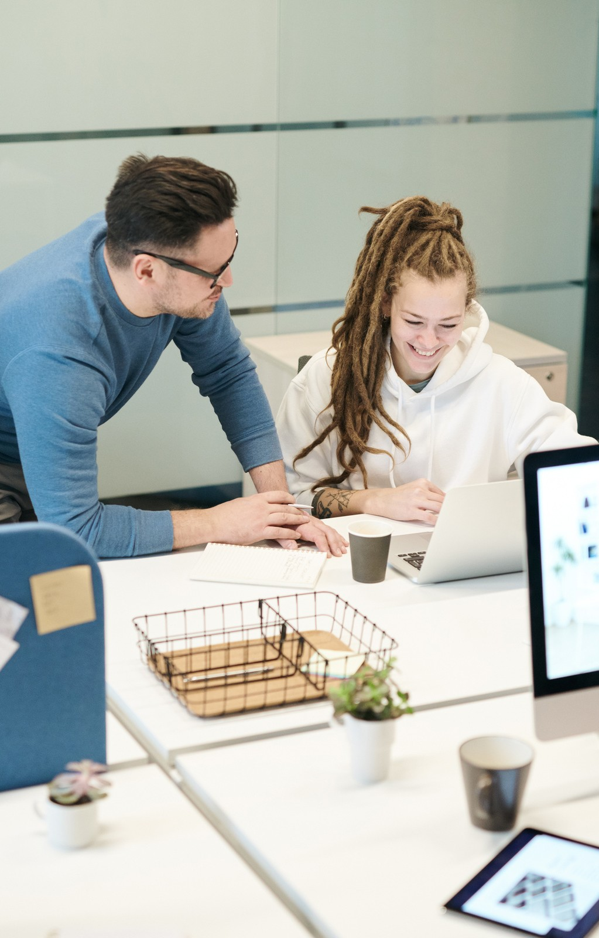
Decision making:
We will strive to base our decisions on data when possible, source the necessary information, discuss the criteria such as cost, time, and impact for selecting an option, consider varied interpretations of data, get input from the whole team prior to making a decision, address any concerns within the team during team meetings or individually instead of airing them to outsiders in an inappropriate manner, and make sure all team members are in agreement with the decision before it's finalized.
Handling a conflict:
We will approach conflict as a chance to develop and strive to grasp the hopes and needs of each individual beforehand when figuring out answers or solutions. We will pick the appropriate moment and setting to go over and inspect the conflict. We will listen to other perspectives with an open mind. We will make sure to verify our understanding of what the other person has said and recognize any valid points they have made. We will express our own views and interests in a respectful and non- confrontational way. Lastly, we will attempt to find a mutual understanding in order to come to an agreement.
Meeting Procedures:
Meetings will start and end at the designated time. Everyone attending should come ready for the meeting. At the close of each meeting, topics for the next one will be discussed. An idea bank should be used to store any topics that arise that are not part of the discussion. If there are any unresolved issues, they will be added to the list of matters to address. If someone is not able to make it, they should send a representative with the authority to make decisions. Duties for the meetings should be rotated among the members.

Slide 12



Retrospective
What was good?
Each of the team member contributed their ideas and analysis to the project . Team meetings were conducted as per the schedule.
Team discussions in meetings helped to proceed with tasks and doubts and able to complete them in time.

Slide 13


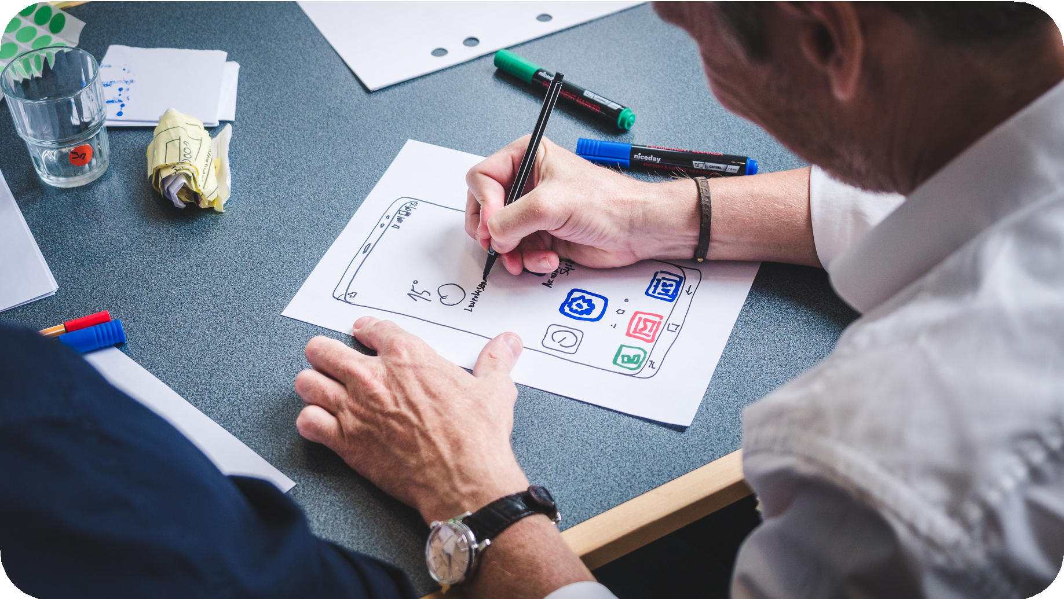
We can improve on?
What we plan to commit for next sprint?
As mentioned, For better communication, we are going to create a Microsoft teams group for the project and use it for project- related meetings and discussions.
We are going to share Meeting of minutes after every meeting so that we can keep track of action items.
Previous teams retro can be helpful in improving Team performance.
Communication and coordination in team members can be improved to take up tasks and complete them parallelly
Deadlines for Tasks can be
followed strictly so that we can avoid last-minute surprises in achieving targets.

Slide 14


https://github.co m/htmw/2023S- Team1
https://github.co m/htmw/2023S- Team1/wiki

Slide 15
THANK YOU

